Slide 1
DEEP LEarNiNg MastEr Class
Day-12

Slide 2
01
Interpretability
Concept

Slide 3
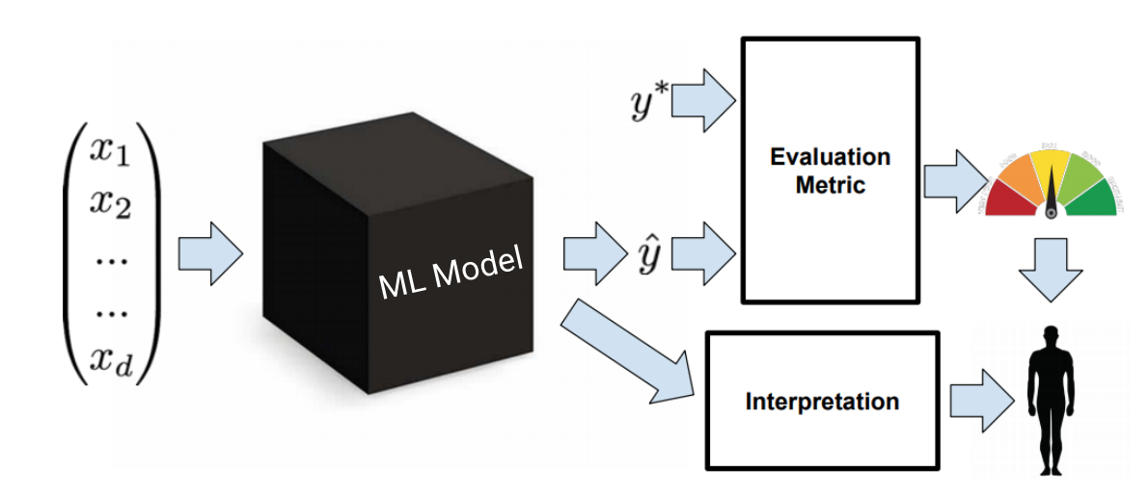
Model interpretability
By model interpretation, one can be able to understand the algorithmic decisions of a machine learning model
It is the ability to approve and interpret the decisions of a predictive model in order to enable transparency in the decision-making process
Python Libraries for Building Interpretable Machine Learning
ELI5
LIME
SHAP
Yellowbrick
Alibi
Lucid
To interpret the models using the predictions and parameters to understand why the classifier chose a particular class for example

Slide 4
Why do we Need Interpretable ML?
Fairness
Employees’ performance, data from the last 10 years,
what if that company tends to promote more men than women? (and this bias has unfortunately happened in certain real-world scenarios).
Now, if there is no way to interpret our model at this stage, the model might end up providing false insights at the cost of compromising on fairness

Slide 5
Why do we Need Interpretable ML?
Checking causality of features & Debugging models
Consider that we are building a model for classifying wolves vs dogs.
Now, what if we have wolves and dogs in entirely different backgrounds?
But on using one of the interpretability methods, we see that our model is actually ignoring the dog and wolf while using just the background pixels for doing the classification.
This model might give a good performance on the validation set as they contain different backgrounds for the wolf and dog respectively
Having an interpretable model, in this case, enables us to test the causality of the features, test its reliability and ultimately can help us to debug the model appropriately.

Slide 6
Why do we Need Interpretable ML?
Regulations
In the banking and finance industry, questions such as the following can come up and have to be answered by these banks:
Why was my loan rejected?
Why did I get a low Credit Limit on my credit card? etc.

Slide 7
When we no Need Interpretable ML?
When interpretability does not impact the end customer
If the problem is well studied, we are confident about the results

Slide 8
Classification of interpretability techniques
Scope
Whether we are looking to interpret globally for all data points, the importance of each variable, or are we looking to explain a particular prediction which is local?
Model
Is whether we are talking about a technique that works across all types of models (model agnostic) or is tailor-made for a particular class of algorithms (model specific).

Slide 9
Yellowbrick
Yellowbrick is used to evaluate the model performance and visualize the model behavior
It is based on the scikit-learn and matplotlib libraries
Yellowbrick uses the concept of ‘Visualisers’. Visualizers are a set of tools that help us visualize the features in our data considering individual datapoints
Visualizers are a set of tools that help us visualize the features in our data considering individual datapoints
List of Visualizers
Rank Features
RadViz Visualizer
Parallel Coordinates
PCA Projection
Manifold Visualization
Direct Data Visualization/Joint Plot Visualiser

Slide 10
ELI5
Inspect model parameters and try to figure out how the model works globally
Inspect an individual prediction of a model and figure out why the model makes the decision.
If Yellowbrick focuses on the features and model performance interpretation, ELI5 focus on the model parameters and the prediction result

Slide 11
SHAP-SHapley Additive explanations
Uses Shapley values at its core and is aimed at explaining individual predictions
Shapley values are derived from Game Theory, where each feature in our data is a player, and the final reward is the prediction. Depending on the reward, Shapley values tell us how to distribute this reward among the players fairly
SHAP using the SHAP values to explain the importance of each feature
SHAP is not limited to global interpretability; it also gives you the function to interpret individual dataset
The best part about SHAP is that it offers a special module for tree-based models

Slide 12
LIME -Local Interpretable Model-Agnostic Explanations
Would you just pull up a review of a movie from some random person and watch it if the person recommends it? No, right? You would read what a well-known movie-critic has to say about the movie and then make a decision. This is because you trust the movie critic’s opinion
Similarly the keyword for building a machine learning model is trust.
It is to provide the reasons why a prediction was made
If a machine learning model predicts that a movie is going to be a blockbuster, LIME highlights the characteristics of the movie that would make it a super hit
Interpretable: The explanation must be easy to understand depending on the target demographic
Local fidelity: The explanation should be able to explain how the model behaves for individual predictions
Model-agnostic: The method should be able to explain any model
Global perspective: The model, as a whole, should be considered while explaining it

Slide 13
Deep Learning Terminology - 1
Embeddings
An embedding is a mapping of a discrete — categorical — variable to a vector of continuous numbers
Typically, an embedding is a translation of a high-dimensional vector into a low-dimensional space
In TensorFlow, embeddings are trained by backpropagating loss just like any other parameter in a neural network.
Finding nearest neighbors in the embedding space. These can be used to make recommendations based on user interests or cluster categories.
As input to a machine learning model for a supervised task.
For visualization of concepts and relations between categories

Slide 14
Deep Learning Terminology - 2
Ensemble
A merger of the predictions of multiple models.
Different initializations
Different hyperparameters
Different overall structure

Slide 15
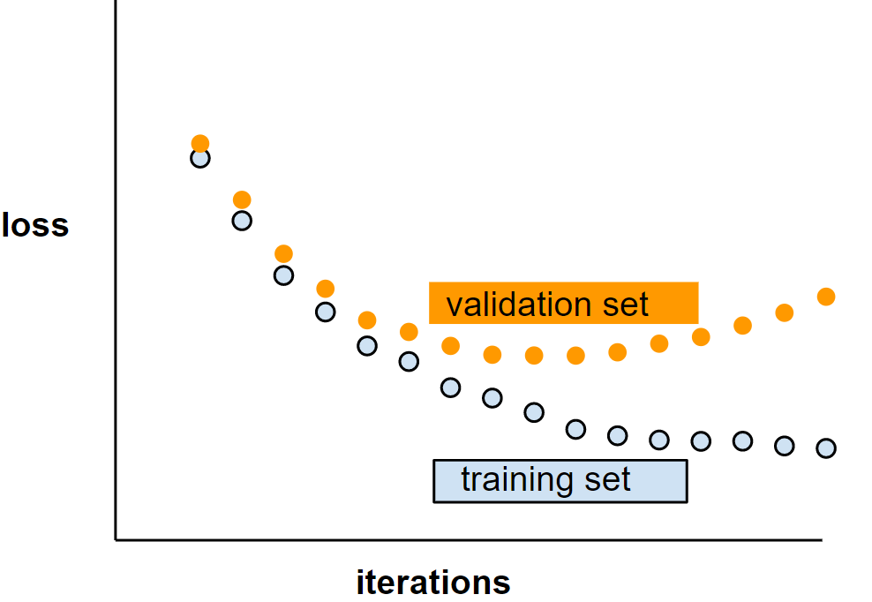
Deep Learning Terminology - 3
Generalization
Refers to your model's ability to make correct predictions on new, previously unseen data as opposed to the data used to train the model.
Generalization curve
A loss curve showing both the training set and the validation set. A generalization curve can help you detect possible overfitting
For example, the following generalization curve suggests overfitting because loss for the validation set ultimately becomes significantly higher than for the training set

Slide 16
Blueprint to Success
Short bytes – D12
Listen to the Audio/Video of
STRANGEST SECRET EARL NIGHTINGALE

Slide 17
Thanks!
Thanks!
Follow Me on LinkedIn : Link in Description
+91 7305845758
Pantechsolutions.net
Ask Your Friends to Participate on this Event

